Slide 1
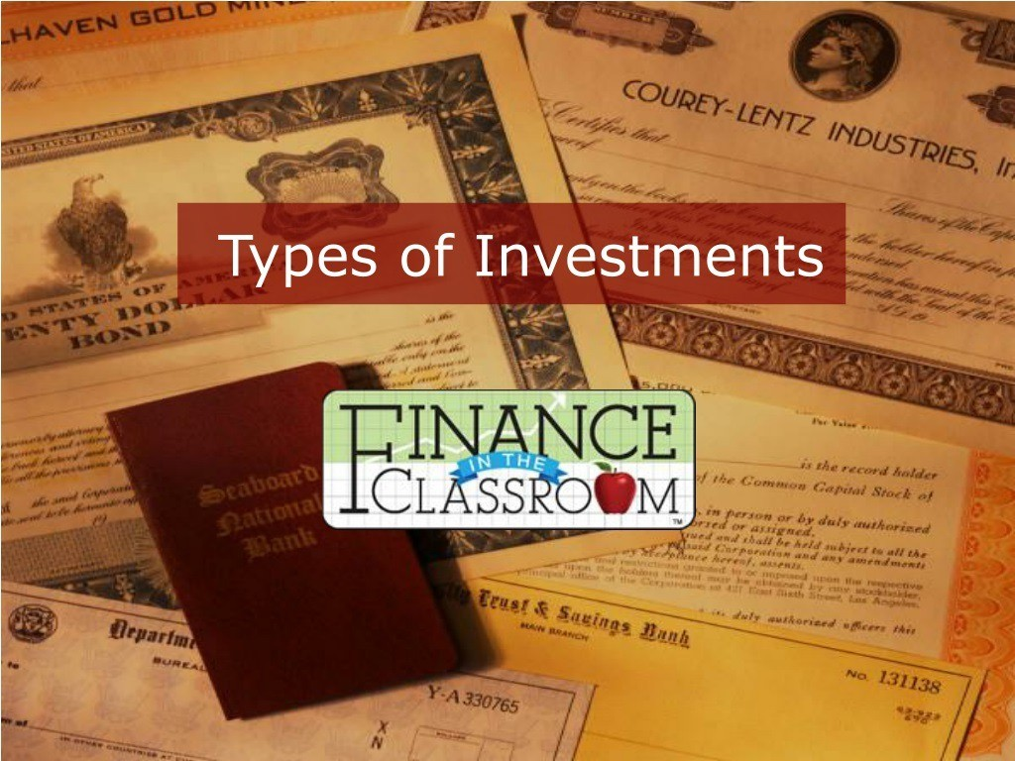

Slide 2
Stocks
Bonds
Mutual Funds
Real Estate
Savings/Certificates of Deposit
Collectibles

Slide 3
An investment that represents ownership in a company or corporation.

Slide 4
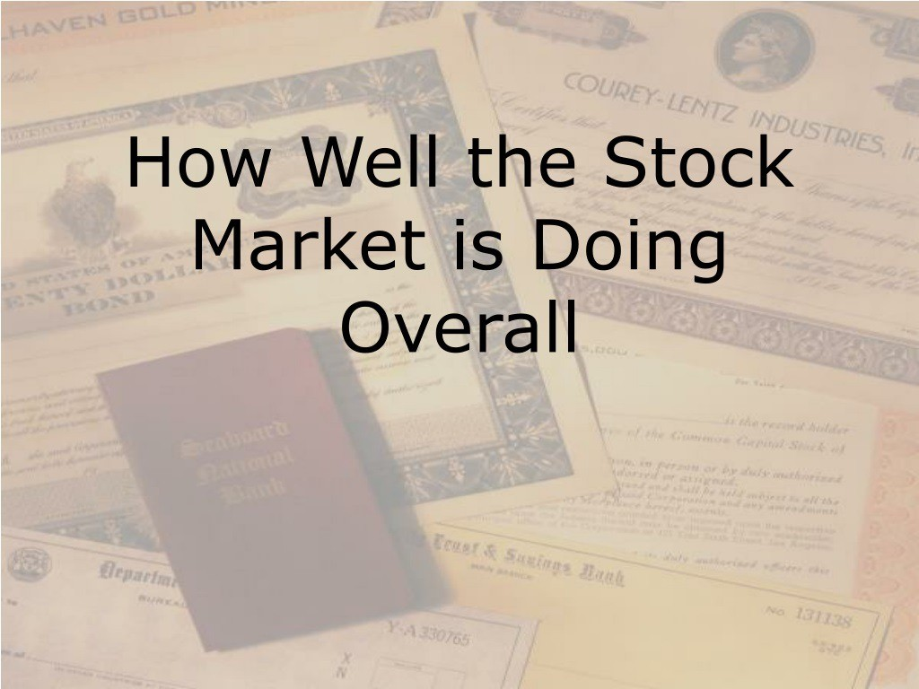

Slide 5
Dow Jones Industrial Average (“DOW”)
Lists the 30 leading industrial blue chip stocks
Standard and Poor's 500 Composite Index
Covers market activity for 500 stocks
More accurate than DOW because it evaluates a greater variety of stock
National Association of Security Dealers Automated Quotations (“NASDAL,j”)
Monitors fast moving technology companies
Speculative stocks, show dramatic ups and downs

Slide 6


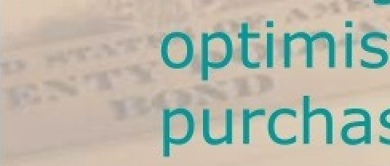




e t
i ,.well” be a
m ac$:thęojąrket•
“”• gc about th
n
.ckś
:arket,
” ” Jlasin
_
1.‹.s..or ₋
OW'd

Slide 7
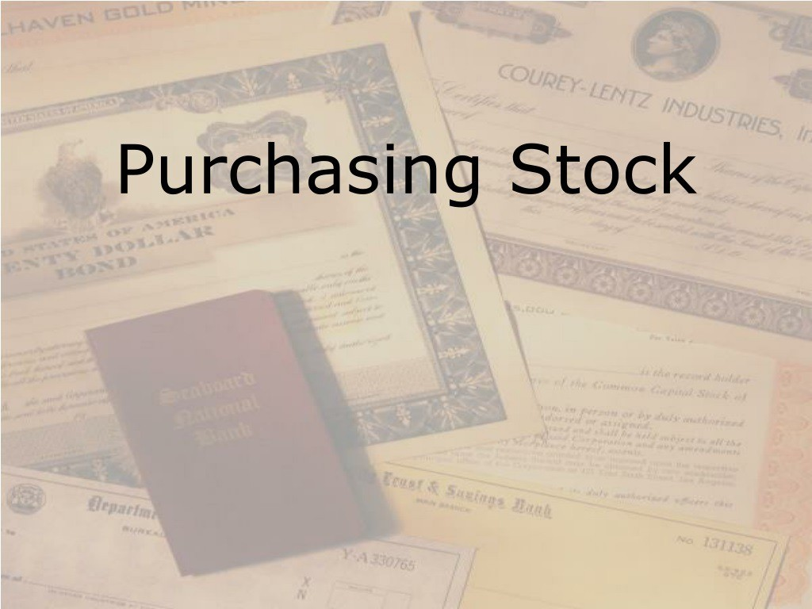

Slide 8
Brokers
A Broker is a person who is licensed to buy and sell stocks, provide investment advice, and collect a commission on each purchase or sale
Purchases stocks on an organized exchange (stock market)
Over ³/4 Of all stoCks are bought and sold
on an organized exchange

Slide 9
Minimum requirements for a stock to ensure only reputable companies are used
Each exchange has a limited number of seats available which brokerage firms purchase to give them the legal right to buy and sell stocks on the exchange

Slide 10
New York Stock Exchange (NYSE)
Oldest and largest, began in 1792
1,366 seats available
—2,800 companies
Average stock price is $33.00
Strict requirements

Slide 11
American Stock Exchange
American Stock Exchange
Began in 1849
—2nd largest exchange
It's requirements are not as strict as NYSE allowing younger, smaller companies to list
Average stock price is $24.00

Slide 12
Regional Stock Exchanges
Stocks are traded to investors living in a specific geographical area
Including Boston, Cincinnati, Philadelphia,
Spokane

Slide 13
National Association of Securities
Dealers Automated Quotations
Stocks are traded in an over the counter electronic market
4,000 small companies
Company requirements are not as strict
More volatile because companies are
young and new
Average stock price is $11.00

Slide 14
A security representing a loan of money from a lender to a borrower for a set time period, which pays a fixed rate of interest.

Slide 15
An investment that pools money from several investors to buy a particular type of investment, such as stocks.

Slide 16
An investor buys pieces of property, such as land or a building, in hopes of generating a profit.

Slide 17
A deposit that earns a fixed interest rate for a specified length of time.
The longer the time period the
greater the rate of return.
There is a substantial penalty for early withdrawal.

Slide 18
Unique items that are relatively rare or highly valued.
- Art work
Baseball trading cards
Coins
Automobiles
Antiques

Slide 19
On average, stocks have a high rate of return
The increase or decrease in the original purchase price of an investment
Higher rate of return = greater risk
Uncertainty about the outcome of an
investment
Stocks provide portfolio diversification
Money invested in a variety of investment tools

Slide 20
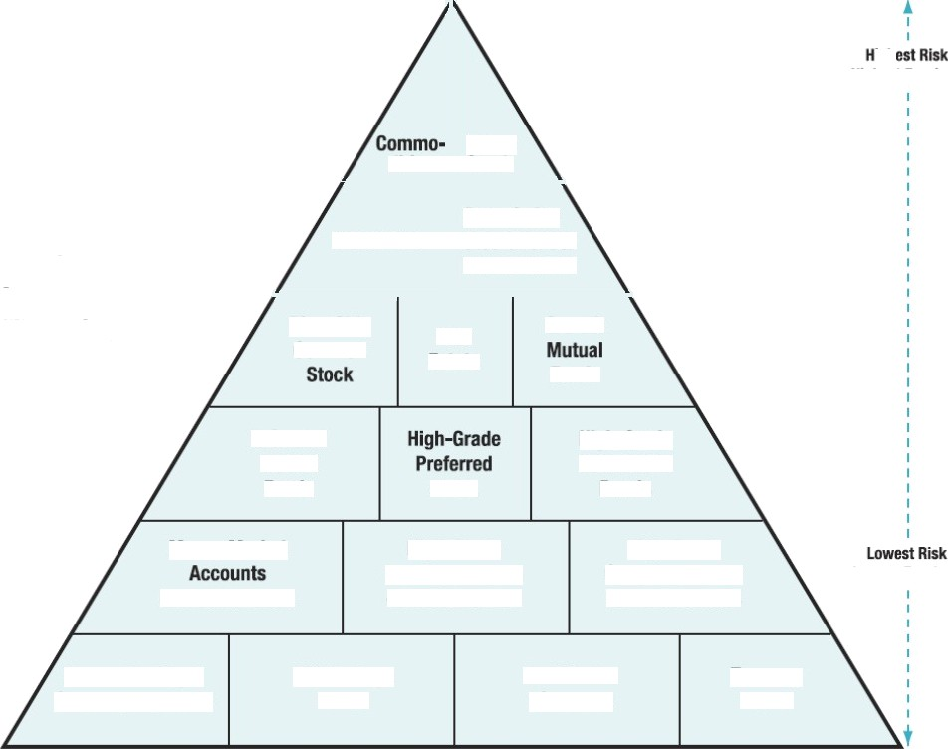





Pa›ny
Variou8 lnve8tment Attst¥\aaVes
âgztual Funds
Blue-Chg
¢on›rnon
High-Grwle
Funds
Stock
Bonds
High-l¥ade Municipal Ba›ds or Uutud Fixids
High-6rade Corporate Banés or MutaslFun4s
or Mutual Funds
irs.»am
Treasury

Slide 21
Short selling is where an investor sells shares of stock that they don't own with the intent to buy them back later at a lower price.
— Let's use rollerblades as an example.

Slide 22
Short selling is where an investor sells shares of stock that they don't own with the intent to buy them back later at a lower price.
— Let's use rollerblades as an example.

Slide 23

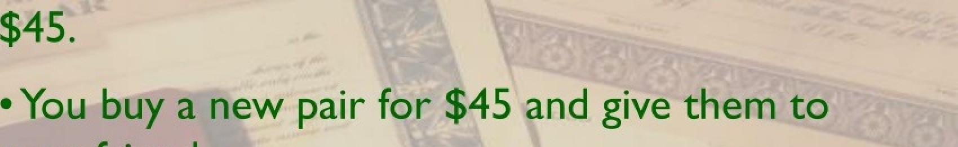


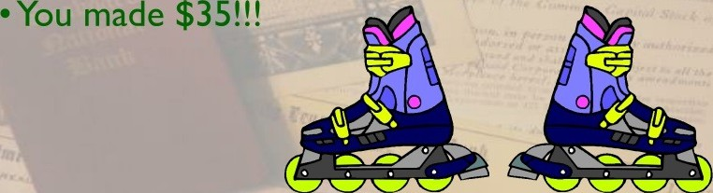
w ollerbladóš’fØ'í*Q8Q„qgp
s II them for $80.
YOțiYFrìèncfb
y.j,. -m..
•You ł/oșąpł.the

Slide 24
Buy and hold technique is where an investor buys stock and holds on to it for a number of years.
—During that time you are paid dividends and the price of the stock may go up.

Slide 25
Buy and hold technique is where an investor buys stock and holds on to it for a number of years.
—During that time you are paid dividends and the price of the stock may go up.

Slide 26
One-Time Investment
Amount Invested |  |  | Share Price ($) |  |  | Shares Purchased
$1,000.00 |  |  | $20.00 |  |  | 50.00
 | $1,000.00 |  |  | $20.00 | 50 |  | 00
Dollar-Cost Averaging
Amount Invested |  |  | Share Price ($) |  | Shares Purchased
$100.00 |  |  | $20.00 |  | 5.00
$100.00 |  |  | $19.50 |  | 5.13
$100.00 |  |  | $19.25 |  | 5.19
$100.00 |  |  | $19.75 |  | 5.06
$100.00 |  |  | $19.20 |  | 5.21
$100.00 |  |  | $18.90 |  | 5.29
$100.00 |  |  | $18.00 |  | 5.56
$100.00 |  |  | $18.60 |  | 5.38
$100.00 |  |  | $19.78 |  | 5.06
$100.00 |  |  | $20.90 |  | 4.78
 | $1,000.00 |  |  | $19.39* |  | 51.66
“Average Share Price

Slide 27
Buy and hold technique is where an investor buys stock and holds on to it for a number of years.
—During that time you are paid dividends and the price of the stock may go up.

Slide 28
Regulatory Pyramid
— A network of safeguards that surrounds the securities industry - from individual brokerages all the way up to the U.S. Congress.

Slide 29
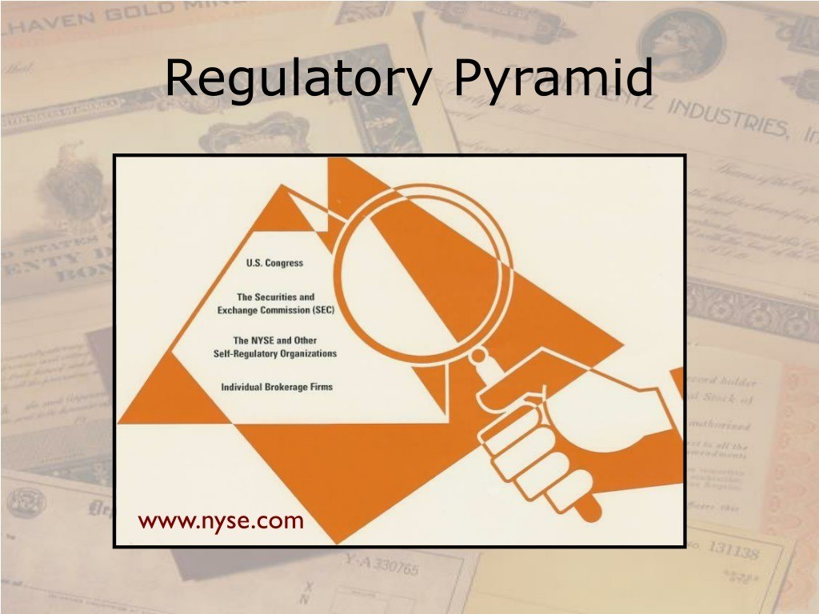

Slide 30
Financial publications
- Wall Street Journal
Fortune
Kiplingers Personal Finance

Slide 31
Financial publications
- Wall Street Journal
Fortune
Kiplingers Personal Finance

Slide 32
Financial publications
- Wall Street Journal
Fortune
Kiplingers Personal Finance

Slide 33
Investments?
Full-service broker
Discount broker
Online broker
•Investmentadvisors

